Slide 1
Crop production Analysis

Slide 2
Problem Statement
The Agriculture business domain, as a vital part of the overall supply chain, is expected to highly evolve in the upcoming years via the developments, which are taking place on the side of the Future Internet. This paper presents a novel Business-to-Business collaboration platform from the agri-food sector perspective, which aims to facilitate the collaboration of numerous stakeholders belonging to associated business domains, in an effective and flexible manner. This dataset provides a huge amount of information on crop production in India ranging from several years.
Based on the Information the ultimate goal would be to predict crop production and find important insights highlighting key indicators and metrics that influence crop production.
Make views and dashboards first and also make a story out of it

Slide 3
Tools & Techniques Used
For creating dynamic , Interactive dashboard – Power BI
Data extraction, Cleaning and preliminary analysis – Excel

Slide 4
Main KPIs
Total Area : This KPI shows the addition of total Area of entire dataset.
Total Season : This KPI shows the count total total season of crop & production.
Total State : This KPI shows the How many states in a data set ?
Total State : This KPI shows the How many states in a data set ?
Total District : This KPI shows the How many District in a data set ?
Total Production : This KPI shows the addition of total Area of entire dataset.

Slide 5
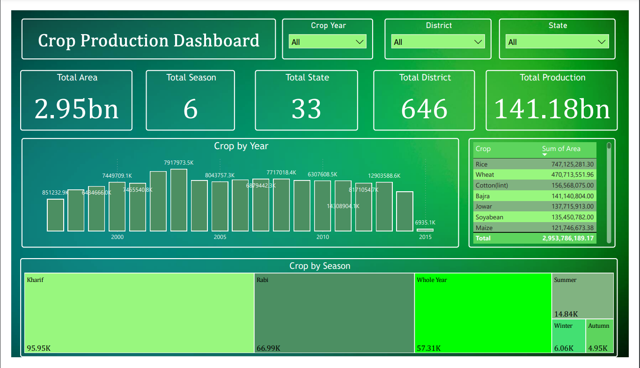
Dashboard Part 1

Slide 6
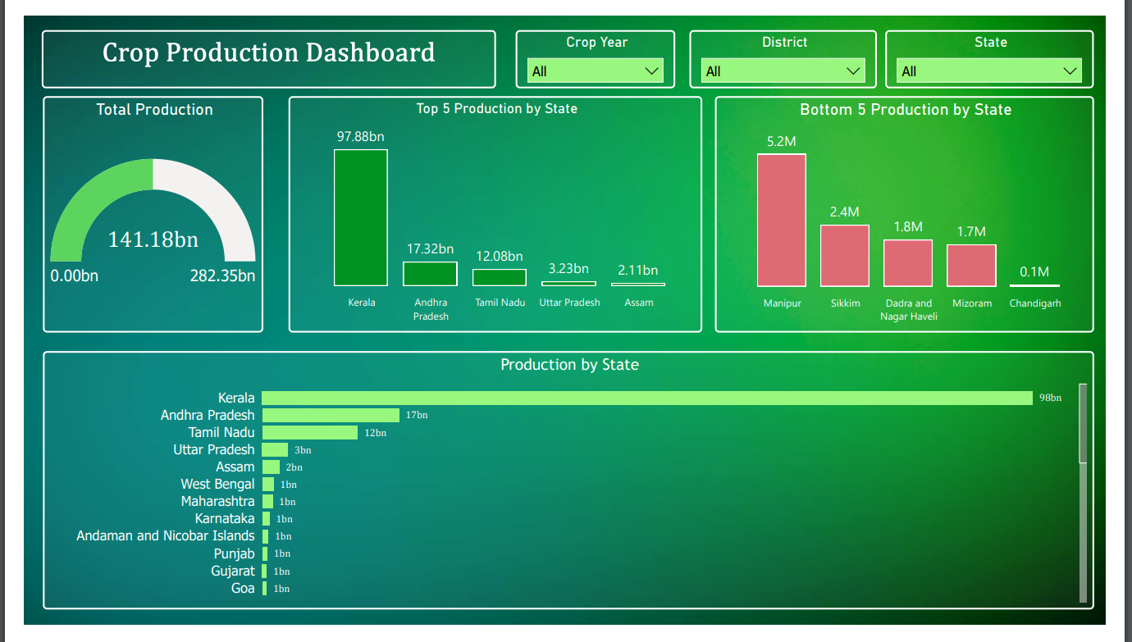
Dashboard Part 2

Slide 7
Insights
Rice is the most-produced crop, with a total production of 747,125,281.30.
Production has been increasing over the past five years, from 744,970,910.0 in 2000 to 8,043,757,300.0 in 2015
The Kharif season is the most productive season, with a total production of 95.95 million

Slide 8
GitHub
https://github.com/Kavan243/Analyzing-Amazon-Sales-data

